Slide 1

Subtopic N2.2 - Mental Strategies for Addition and Subtraction
LEARNING OUTCOME: To understand the properties of addition and subtraction.
Keywords:
Integer
Total
Sum
Number Line
Objectives:
To use a number line for addition and subtraction.
To use number bonds for addition and subtraction.
To understand commutativity in addition.
To represent addition and subtraction using visual models.
Introduction – Read and annotate:
In this subtopic, we want you to get really good at mental addition and subtraction. We start out by
using number lines as support, but you should aim to move away from these as quickly as possible.
Being quick at mental addition and subtraction will make every maths topic that follows this much
easier!
Definition
Characteristics
The sum of two or more numbers.
We can add with integers, decimals, fractions and many other types of number.
Addition is commutative, e.g. 5 + 6 = 6 + 5
Examples
Addition
Non - Examples
4 + 4 = 8
10 - 5 = 5
+
+
+
+
+
+
+
+
Addition using number lines as scaffolds
Example 1 - I do…
Example 2 - We do…
Use the number line to calculate 4 + 3
Use the number line to calculate 5 + 2
4 + 3 =
7
5 + 2 =
7
Example 3 - You do…
Example 4 - You do…
Use the number line to calculate 1 + 3
Use the number line to calculate 6 + 2
1 + 3 =
4
6 + 2 =
8

Slide 2

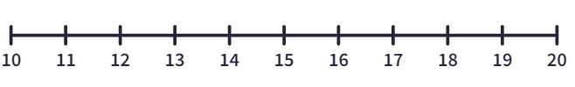
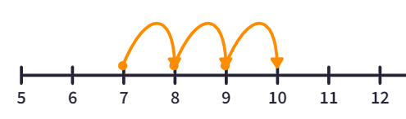
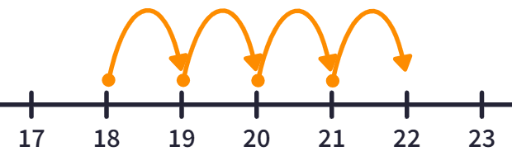
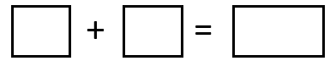
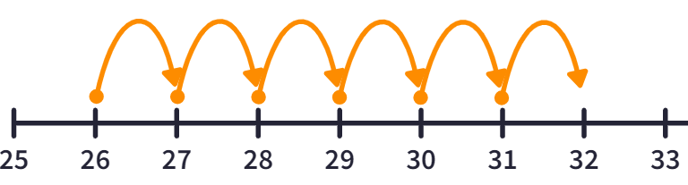
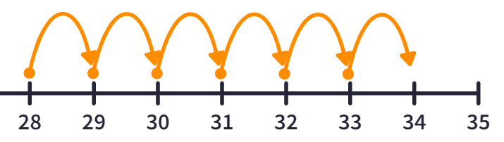
o) 6 + 5
p) 6 + 6
11
12
q) 6 + 7
r) 7 + 6
13
13
s) 7 + 7
t) 8 + 7
14
15
u) 10 + 4
v) 10 + 6
14
16
w) 11 + 4
x) 13 + 5
15
18
Example 5 - I do…
Example 6 - We do…
What addition is being shown on the number line?
What addition is being shown on the number line?
7 3 10
18 4 22
Example 7 - You do…
Example 8 - You do…
What addition is being shown on the number line?
What addition is being shown on the number line?
26 6 32
28 6 34
‹#›

Slide 3
Independent Practice
3. Fill in the addition facts and the bar models
Question | Addition Fact | Bar Model
a)
5
5 + 5 = 10
10
10
5
5 + 5 = 10
5
5
b)
c)
d)
e)
f)
g)
h)
i)
4
4 + 5 = 9
9
5 + 4 = 9
4
9
5
5
4
4 + 6 = 10
10
10
6
6 + 4 = 10
4
6
6
6 + 6 = 12
12
12
6
6 + 6 = 12
6
6
6
6 + 7 = 13
13
13
7
7 + 6 = 13
7
6
7
7 + 7 = 14
14
14
7
7 + 7 = 14
7
7
5
5 + 7 = 12
12
12
7 + 5 = 12
7
5
7
7
7 + 9 = 16
16
16
7
9
9
9 + 7 = 16
9
9 + 9 = 18
18
18
9
9
9
9 + 9 = 18

Slide 4
Question | Addition Fact | Bar Model
j)
k)
l)
m)
n)
o)
p)
q)
9
9 + 10 = 19
19
19
10
10 + 9 = 19
9
10
10
10 + 9 = 19
19
19
9
9 + 10 = 19
10
9
9
9 + 11 = 20
20
20
11
11 + 9 = 20
9
11
11
11 + 11 = 22
22
22
11
11 + 11 = 22
11
11
11
11 + 12 = 23
23
23
12
12 + 11 = 23
11
12
12
12 + 11 = 23
23
23
11
11 + 12 = 23
12
11
12
12 + 14 = 26
26
26
14
14 + 12 = 26
12
14
14
14 + 16 = 30
30
30
16
16 + 14 = 30
14
16

Slide 5
Question | Addition Fact | Bar Model
r)
s)
t)
u)
v)
w)
x)
y)
9
9 + 1 = 10
10
10
1
1 + 9 = 10
9
1
2
2 + 10 = 12
12
12
10
10 + 2 = 12
10
2
6
6 + 10 = 16
16
16
10
10 + 6 = 16
6
10
4
4 + 12 = 16
16
16
12
12 + 4 = 16
12
4
12
12 + 4 = 16
16
16
4
4 + 12 = 16
4
12
11
11 + 15 = 26
26
26
15
15 + 11 = 26
11
15
13
13 + 7 = 20
20
20
7
7 + 13 = 20
13
7
12
12 + 13 = 25
25
25
13
12 + 13 = 25
12
13

Slide 6
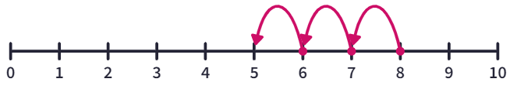
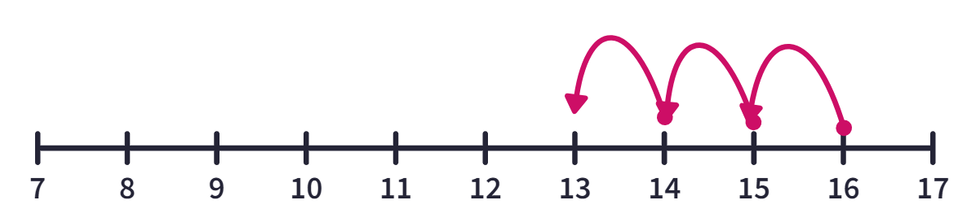




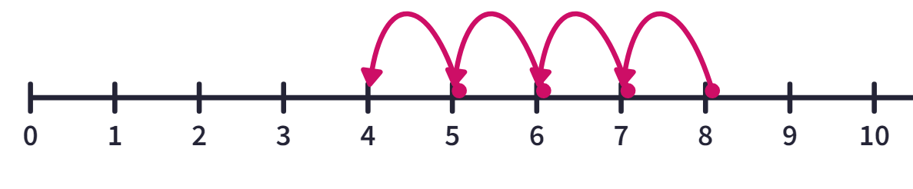
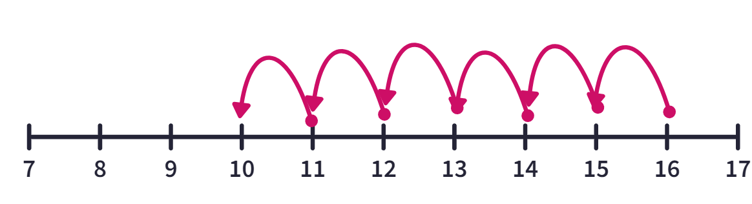




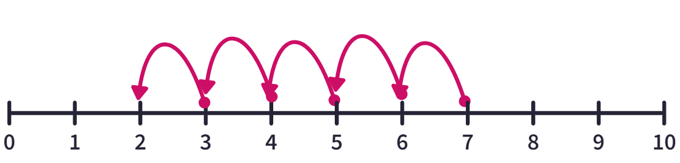
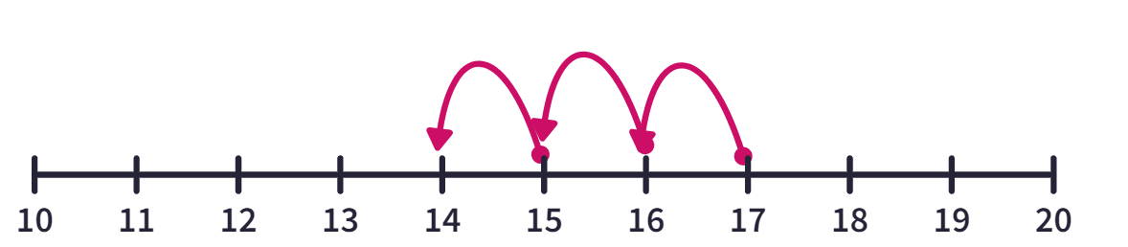




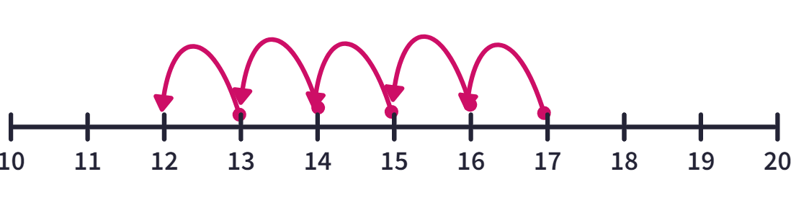
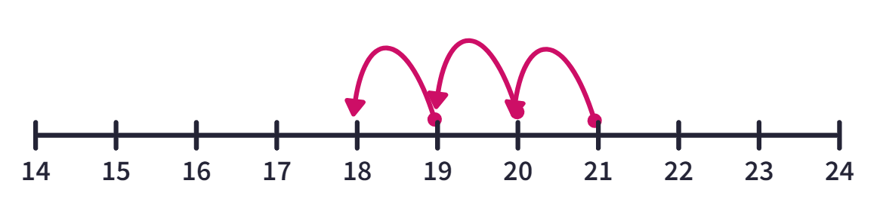




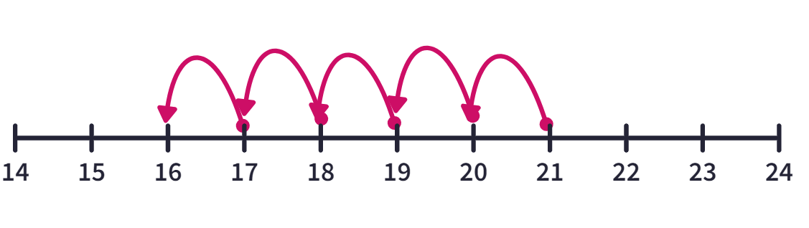
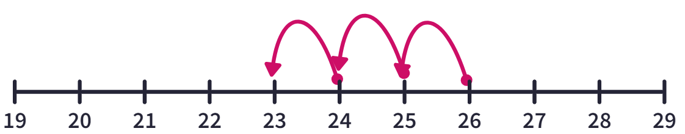




Example 16 - I do…
Example 17 - We do…
What calculation is being shown on the number line?
What calculation is being shown on the number line?
8
3
5
16
3
13
Example 18 - You do…
Example 19 - You do…
What calculation is being shown on the number line?
What calculation is being shown on the number line?
8
4
4
16
6
10
Independent Practice
5. What calculation is being shown on the number line?
a)
b)
7
5
2
17
3
14
c)
d)
17
5
12
21
3
18
e)
f)
21
5
16
26
3
23

Slide 7
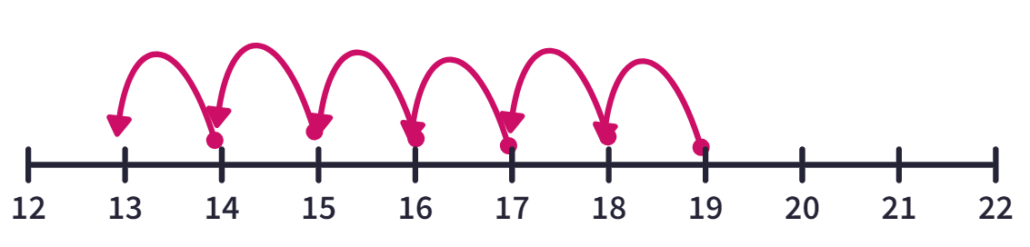
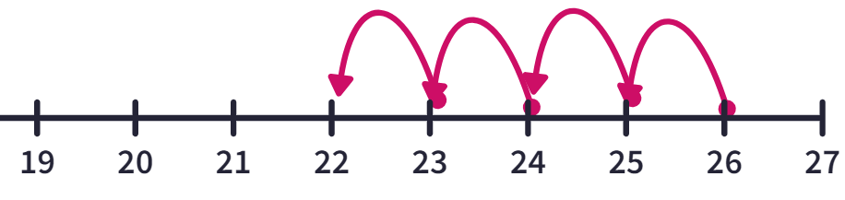




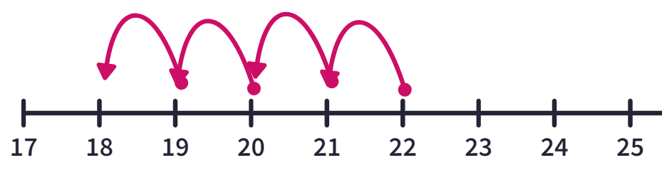
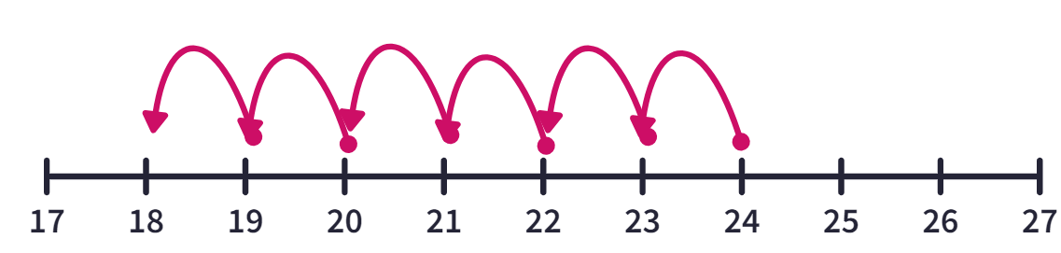




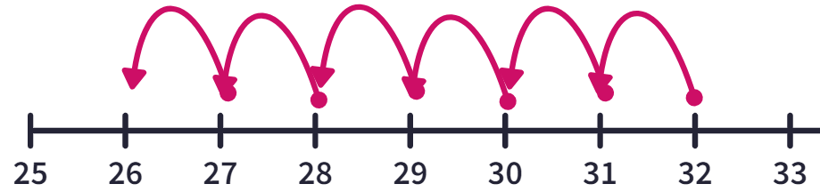
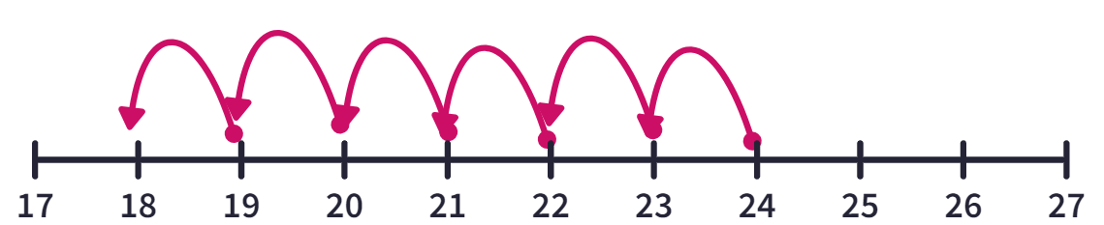




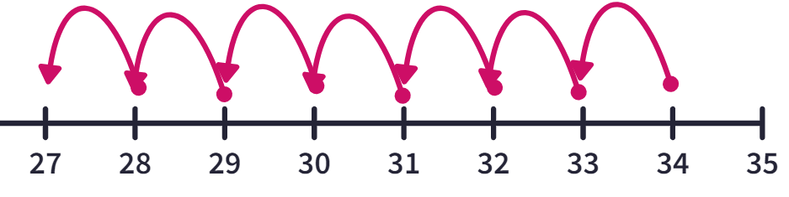
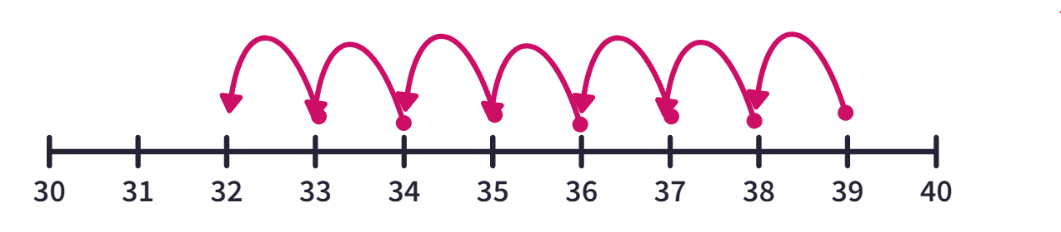




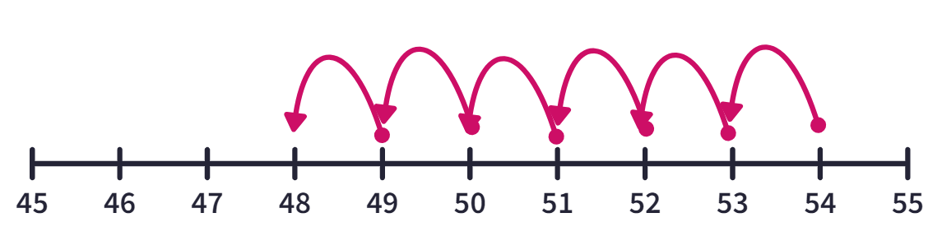
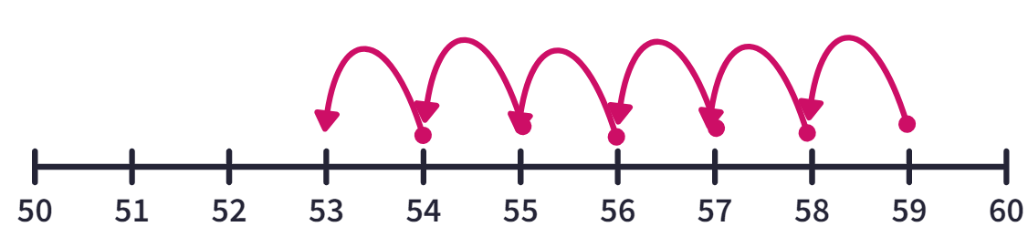

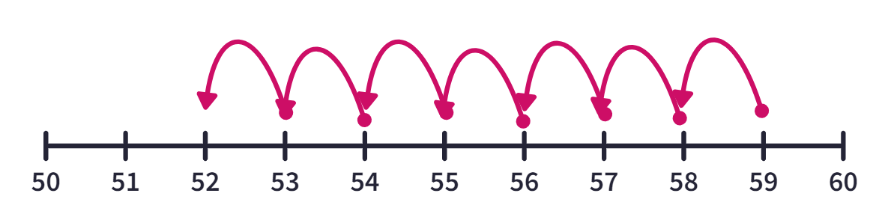
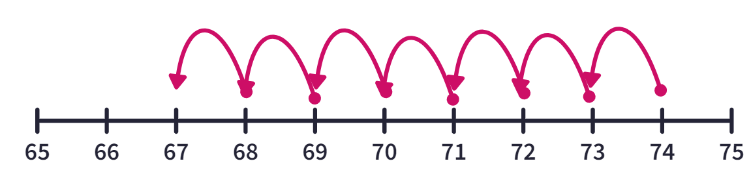
g)
h)
19
6
13
26
4
22
i)
j)
22
4
18
24
6
18
k)
l)
32
6
26
24
6
18
m)
n)
34
7
27
39
32
7
o)
p)
54
6
48
59
6
53
q)
r)
59
7
52
74
7
67

Slide 8
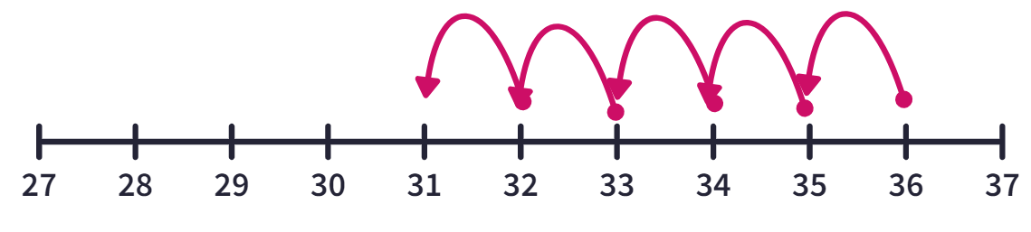
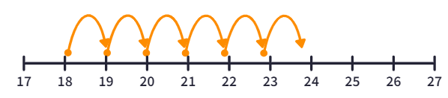
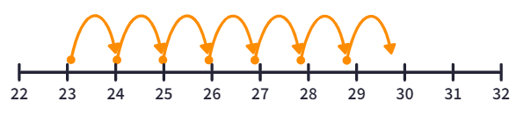
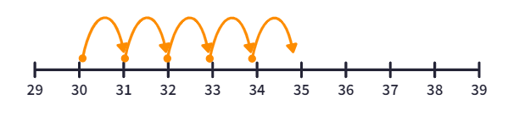
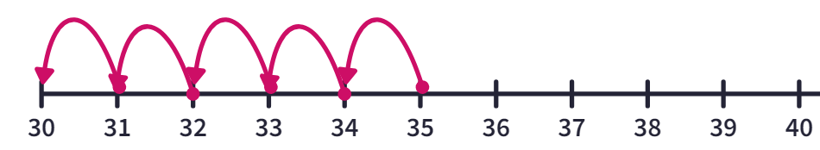
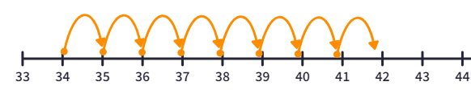
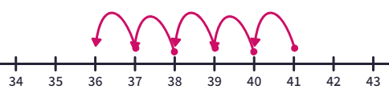
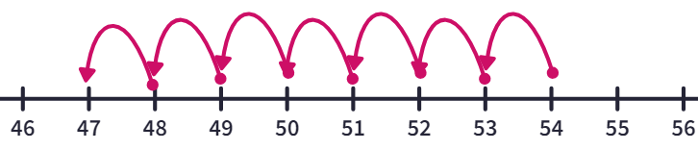
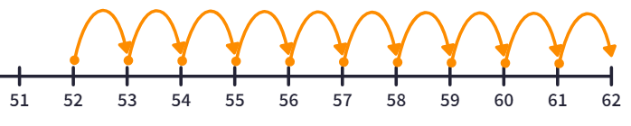
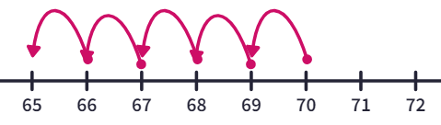
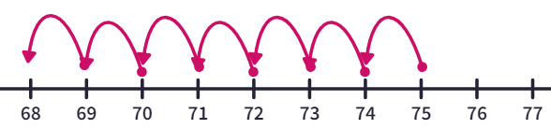
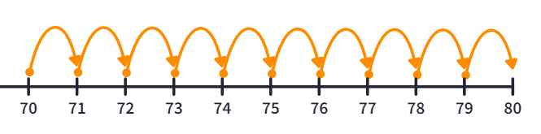
6. What calculation is being shown on the number line? (Pay attention to the direction of the arrows)
a)
b)
36 – 31 = 5
18 + 6 = 24
c)
d)
23 + 7 = 30
30 + 5 = 35
e)
f)
35 – 5 = 30
34 + 8 = 42
g)
h)
42 – 6 = 36
54 – 7 = 47
i)
j)
52 + 10 = 62
70 - 5 = 65
k)
l)
75 - 7 = 68
70 + 10 = 80

Slide 9
Example 20 - I do…
Subtraction Fact | Bar Model
Fill in the blanks and write in the subtraction facts
Use the subtraction facts to fill in the bar model
4
4 + 1 = 5
5
5
1
1 + 4 = 5
1
4
Example 21 - We do…
Subtraction Fact | Bar Model
Fill in the blanks and write in the subtraction facts
Use the subtraction facts to fill in the bar model
4
4 + 3 = 7
7
7
3
3 + 4 = 7
3
4
Example 22 – You do…
Subtraction Fact | Bar Model
Fill in the blanks and write in the subtraction facts
Use the subtraction facts to fill in the bar model
4
4 + 6 = 10
10
10
6
6 + 4 = 10
4
6
Independent Practice
7. Write in the subtraction facts and fill in the blanks.
Question | Subtraction Fact | Bar Model
a)
2
2 + 2 = 4
4
4
2
2
2 + 2 = 4
2

Slide 10
Question | Subtraction Fact | Bar Model
b)
c)
d)
e)
f)
g)
h)
i)
3
3 + 1 = 4
4
4
1
1 + 3 = 4
1
3
4
4 + 1 = 5
5
5
1
1 + 4 = 5
1
4
2
2 + 3 = 5
5
5
3
3
3 + 2 = 5
2
2
2 + 4 = 6
6
6
4
4
4 + 2 = 6
2
3
3 + 3 = 6
6
6
3
3 + 3 = 6
3
3
4
4 + 4 = 8
8
8
4
4 + 4 = 8
4
4
3
3 + 7 = 10
10
10
7
7 + 3 = 10
3
7
4
4 + 6 = 10
10
10
6
6 + 4 = 10
4
6

Slide 11
Question | Subtraction Fact | Bar Model
j)
k)
l)
m)
n)
o)
p)
q)
5
5 + 7 = 12
12
12
7
7 + 5 = 12
5
7
7
7 + 8 = 15
15
15
8
8 + 7 = 15
8
7
8
8 + 8 = 16
16
16
8
8
8
8 + 8 = 16
6
6 + 10 = 16
16
16
10
10 + 6 = 16
10
6
4
4 + 12 = 16
16
16
12
12 + 4 = 16
12
4
13
13 + 3 = 16
16
16
3
3 + 13 = 16
13
3
14
14 + 6 = 20
20
20
6
6 + 14 = 20
6
14
9
9 + 11 = 20
20
20
11
11 + 9 = 20
11
9

Slide 12
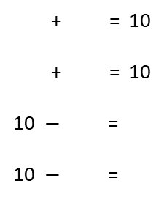
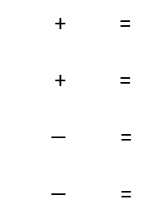
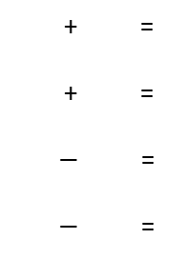
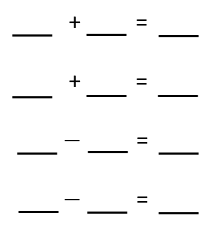
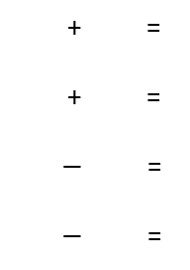
Example 23 - I do…
Example 24 - We do…
Example 25 - You do…
Fill in the missing part of the bar model.
Use this information to complete the number family.
Fill in the missing part of the bar model.
Use this information to complete the number family.
Fill in the missing part of the bar model.
Use this information to complete the number family.
10
8
9
6
4
6
2
6
3
6 4
6 2 8
6 3 9
4 6
2 6 8
3 6 9
6 4
8 6 2
9 6 3
4 6
8 2 6
9 3 6
Independent Practice
8. Fill in the missing part of the bar model. Use this information to complete the number family.
a)
10
b)
10
c)
10
d)
10
4
6
5
5
1
9
8
2
4 6 10
5 5 10
1 9 10
8 2 10
6 4 10
5 5 10
9 1 10
2 8 10
10 4 6
10 5 5
10 1 9
10 8 2
10 6 4
10 5 5
10 9 1
10 2 8
e)
f)
8
g)
h)
7
6
9
4
3
4
4
4
2
4
5
4 3 7
4 4 8
4 2 6
4 5 9
3 4 7
4 4 8
2 4 6
5 4 9
7 4 3
8 4 4
6 4 2
9 4 5
7 3 4
8 4 4
6 2 4
9 5 4
‹#›

Slide 13
i)
j)
k)
l)
11
11
12
15
10
1
5
6
4
8
10
5
10 1 11
5 6 11
4 8 12
10 5 15
1 10 11
6 5 11
8 4 12
5 10 15
11 10 1
11 5 6
12 4 8
15 5 10
11 1 10
11 6 5
12 8 4
15 10 5
m)
n)
o)
p)
20
20
20
20
10
10
12
8
5
15
8
12
10 10 20
12 8 20
5 15 20
8 12 20
10 10 20
8 12 20
15 5 20
12 8 20
20 10 10
20 12 8
20 5 15
20 8 12
20 10 10
20 8 12
20 15 5
20 12 8
q)
r)
18
s)
t)
17
16
19
4
13
8
10
7
9
3
16
4 13 17
8 10 18
7 9 16
3 16 19
13 4 17
10 8 18
9 7 16
16 3 19
17 4 13
18 8 10
16 7 9
19 3 16
17 13 4
18 10 8
16 9 7
19 16 3

Slide 14
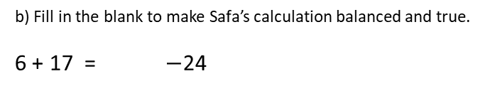






u)
v)
w)
x)
22
24
25
30
10
12
15
9
4
21
14
16
10 12 22
15 9 24
4 21 25
14 16 30
12 10 22
9 15 24
21 4 25
16 14 30
22 10 12
24 15 9
25 4 21
20 14 16
22 12 10
24 9 15
25 21 4
20 16 14
y)
z)
a1)
b1)
27
33
36
41
11
16
15
18
7
29
23
18
11 16 27
15 18 33
7 29 36
23 18 41
16 11 27
18 15 33
29 7 36
18 23 41
27 11 16
33 15 18
36 7 29
41 23 18
27 16 11
33 18 15
36 29 7
41 18 23
9. a) Safa is writing out a calculation in her maths booklet. She says that the calculation 6 + 17 is equal to the calculation 17 – 6. Show that she is incorrect.
6 + 17 = 23 17 – 6 = 11
47
10. Fill in the blanks to balance the calculation and make it true.
Multiple answers. Example answers below
16
20
18
50
3
18
13
100
16
47
171
33

Slide 15
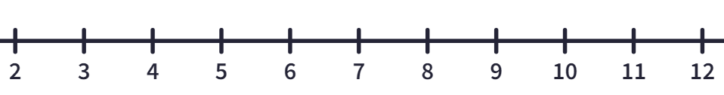
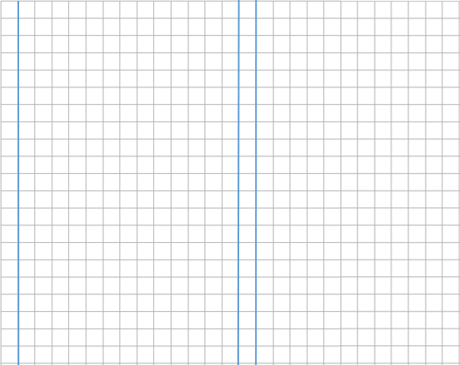
Skills Check
1. Use the number line to perform the calculation
11 - 7
2.
2
2 + 3 = 5
5
3
3 + 2 = 5
What is the missing number?
4
a) 1 b) 2 c) 3 d) 4
3.
4. What is the subtraction fact(s) associated with this addition fact? Circle all that apply.
7
6 + 7 = 13
7 + 6 = 13
4
What is the missing number?
13 – 6 = 7
b) 6 – 13 = 7
c) 13 – 7 = 6
d) 7 – 13 = 6
a) 4 b) 3 c) 7 d) 5

